Slide 1
Before we start
Do you have these installed?
Eclipse
AWS Toolkit for Eclipse
JDK 6 or 7
Tomcat 7
If not:
Go to events-aws.qwiklab.com
Sign up, sign in
Click ‘Instruction 2’, download pre-work.pdf and follow the directions

Slide 2

Coding a Scalable Calculator with VBScript
Evan Brown, Amazon Web Services
@evandbrown
November 12, 2013

Slide 3
Coding a Scalable Java Web Application with AWS Elastic Beanstalk and the AWS SDK for Java
Evan Brown, Amazon Web Services
@evandbrown
@aws_eb
November 12, 2013

Slide 4





Here to Help
Adam DJ Jay John Prashant

Slide 5
Logistics
Breaks at 10:30a and 2:30p
Lunch at 12:30p

Slide 6
Pre-Work
Do you have these installed?
Eclipse
AWS Toolkit for Eclipse
JDK 6 or 7
Tomcat 7
If not:
Go to events-aws.qwiklab.com
Sign up, sign in
Click the ‘Instruction 2’, download pre-work.pdf and follow the directions

Slide 7
Important
Do not use your own AWS account for this workshop

Slide 8

Start the Lab (Deploy the App)
Go to events-aws.qwiklab.com
Sign Up, Sign In
Click Start Lab
Download PDF in Instructions 1 tab
Pre-work PDF in Instructions 2 tab (if you need it)
Sample video in Instructions 3 tab
Download slides: http://bit.ly/aws-reinvent-java

Slide 9
Five things before the next lab
About the app
App Architecture
CloudFormation
Develop/Deploy Workflow on EB
API Credentials

Slide 10

About the App

Slide 11
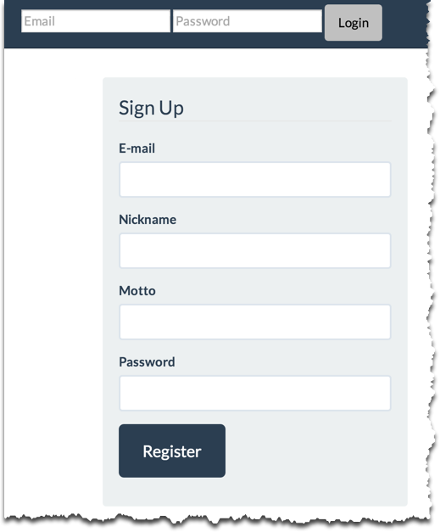
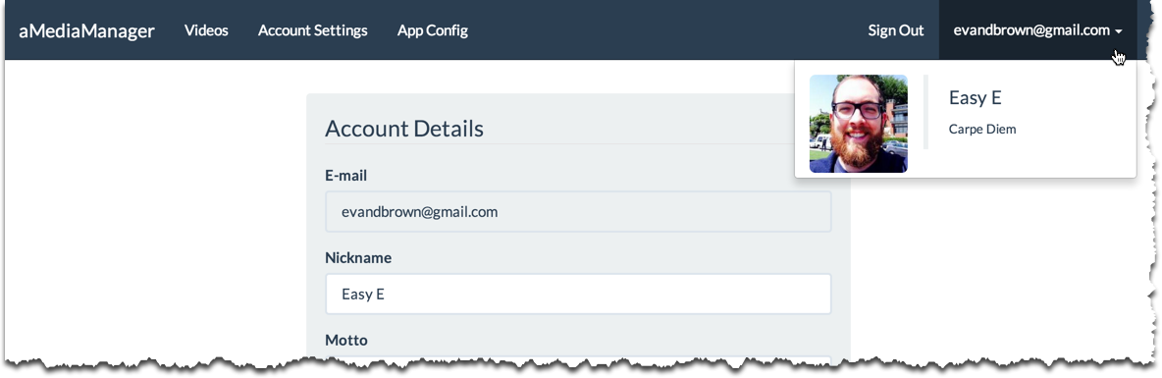
aMediaManager
User profiles

Slide 12
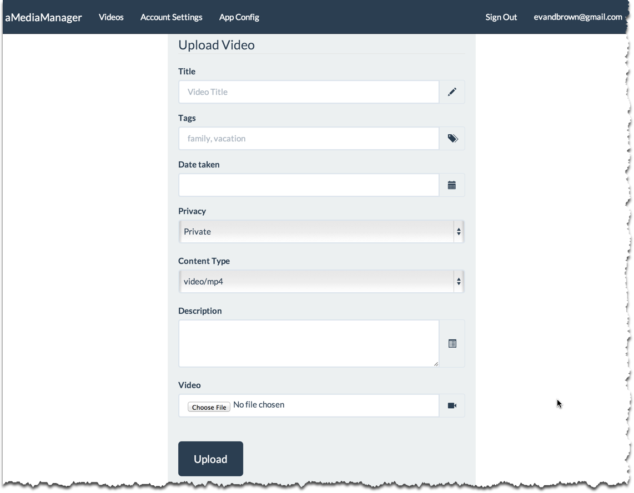
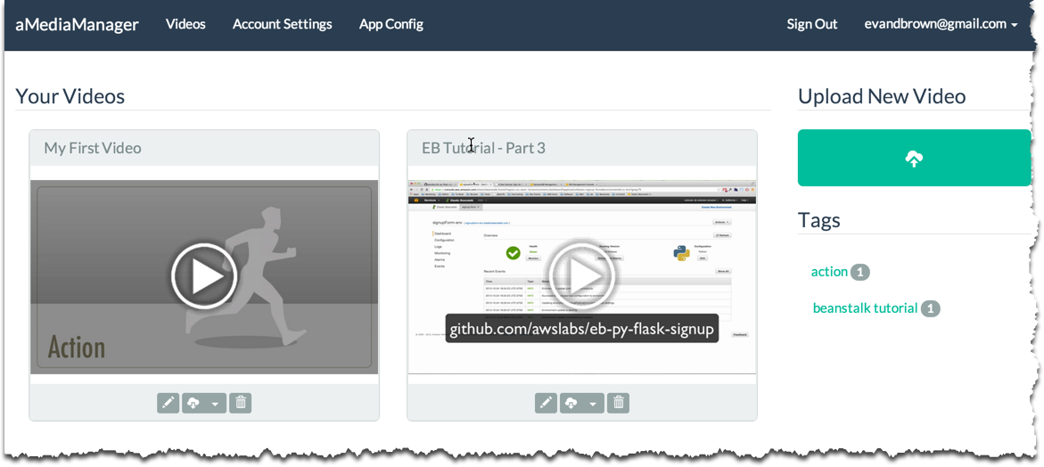
aMediaManager
Video Upload, Transcode, and Streaming

Slide 13
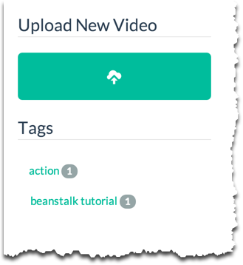
aMediaManager
Video Tagging

Slide 14
aMediaManager: Tech
AWS SDK for Java
AWS Toolkit for Eclipse
Spring 3.2
Spring Security 3.1
Spring Web MVC
ThymeLeaf (template engine)
Apache commons-*

Slide 15
aMediaManager: Tech
AWS SDK for Java
AWS Toolkit for Eclipse
Spring 3.2
Spring Security 3.1
Spring Web MVC
ThymeLeaf (template engine)
Apache commons-*

Slide 16







Architecture
your-app.elasticbeanstalk.com
Alert
ELB
Log
Elastic Beanstalk
Mon
App
AZ

Slide 17
Architecture
your-app.elasticbeanstalk.com
Alert
ELB
Log
Elastic Beanstalk
Mon
App
AZ

Slide 18
Architecture
your-app.elasticbeanstalk.com
Alert
ELB
Log
Elastic Beanstalk
Mon
App
AZ

Slide 19
Architecture
your-app.elasticbeanstalk.com
Alert
ELB
Log
Elastic Beanstalk
Mon
App
AZ

Slide 20


Architecture
your-app.elasticbeanstalk.com
Users Table (DynamoDB)
Alert
ELB
Log
Elastic Beanstalk
MySQL Primary
(RDS)
Mon
App
AZ

Slide 21
Architecture
your-app.elasticbeanstalk.com
Users Table (DynamoDB)
Alert
ELB
Log
Elastic Beanstalk
MySQL Primary
(RDS)
Mon
App
AZ
App Storage
(S3)

Slide 22


Architecture
your-app.elasticbeanstalk.com
Users Table (DynamoDB)
Transcoding Notifications
(SQS)
Alert
ELB
Log
Elastic Beanstalk
MySQL Primary
(RDS)
Transcoding Notifications
(SNS)
Mon
App
AZ
App Storage
(S3)

Slide 23

Architecture
your-app.elasticbeanstalk.com
Users Table (DynamoDB)
Transcoding Notifications
(SQS)
Alert
ELB
Log
Elastic Beanstalk
MySQL Primary
(RDS)
Transcoding Notifications
(SNS)
Mon
App
AZ
App Storage
(S3)
IAM Instance Profile

Slide 24

Architecture
your-app.elasticbeanstalk.com
Users Table (DynamoDB)
Transcoding Notifications
(SQS)
Alert
ELB
Log
Elastic Beanstalk
MySQL Primary
(RDS)
Transcoding Notifications
(SNS)
Mon
App
AZ
App Storage
(S3)
IAM Instance Profile

Slide 25

CloudFormation
your-app.elasticbeanstalk.com
Users Table (DynamoDB)
Transcoding Notifications
(SQS)
Alert
ELB
Log
Elastic Beanstalk
CloudFormation Template
MySQL Primary
(RDS)
Transcoding Notifications
(SNS)
Mon
App
AZ
App Storage
(S3)
IAM Instance Profile

Slide 26
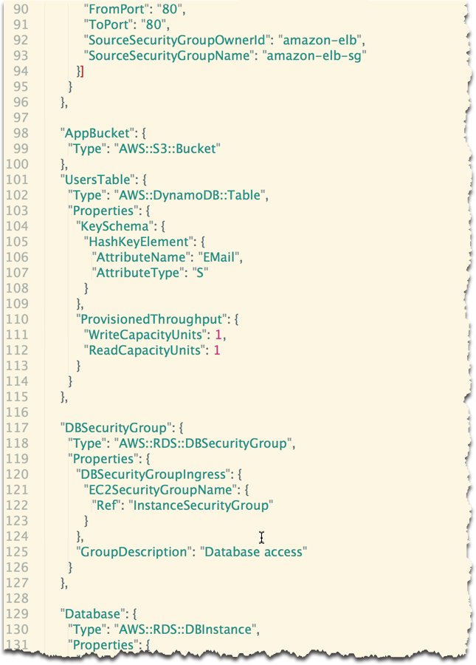
CloudFormation
CloudFormation Template

Slide 27
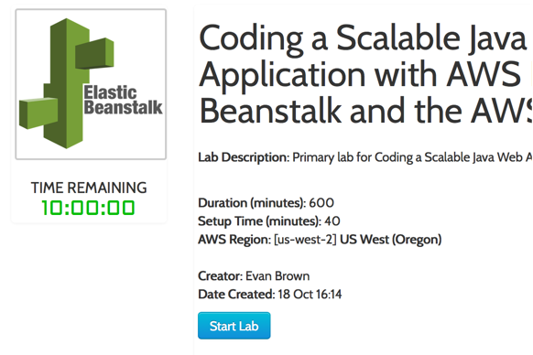
CloudFormation

Slide 28
Develop and Deploy

Slide 29


Develop and Deploy
your-app.elasticbeanstalk.com
Local Dev
Alert
ELB
Log
Elastic Beanstalk
Mon
App
AZ

Slide 30

Develop and Deploy
your-app.elasticbeanstalk.com
Local Dev
Alert
ELB
Log
Elastic Beanstalk
Mon
App
AZ

Slide 31
Develop and Deploy
your-app.elasticbeanstalk.com
App Versions
Local Dev
V1.0
Alert
ELB
Log
Elastic Beanstalk API
Elastic Beanstalk
Mon
App
AZ

Slide 32

Develop and Deploy
your-app.elasticbeanstalk.com
App Versions
Local Dev
V1.0
Alert
ELB
Log
v1.1
Elastic Beanstalk
Elastic Beanstalk API
Mon
App
AZ

Slide 33
Develop and Deploy
Any questions?

Slide 34
API Credentials

Slide 35
API Credentials
Credentials are important, mmkay?

Slide 36
API Credentials
What are these creds called?

Slide 37
API Credentials
What are these creds called?
Access Key and Secret Key

Slide 38
API Credentials
When are they used?

Slide 39
API Credentials
When are they used?
To sign requests made by our app to AWS APIs

Slide 40
API Credentials: Local Dev
your-app.elasticbeanstalk.com
Local Dev
Users Table (DynamoDB)
Transcoding Notifications
(SQS)
Alert
ELB
Log
Elastic Beanstalk
MySQL Primary
(RDS)
Transcoding Notifications
(SNS)
Mon
App
AZ
App Storage
(S3)
IAM Instance Profile

Slide 41
API Credentials: Local Dev
When does your local dev env need an AK/SK?
your-app.elasticbeanstalk.com
Local Dev
Users Table (DynamoDB)
Transcoding Notifications
(SQS)
Alert
ELB
Log
Elastic Beanstalk
MySQL Primary
(RDS)
Transcoding Notifications
(SNS)
Mon
App
AZ
App Storage
(S3)
IAM Instance Profile

Slide 42
API Credentials: Local Dev
Eclipse calls EB:CreateApplicationVersion
your-app.elasticbeanstalk.com
Local Dev
Users Table (DynamoDB)
Transcoding Notifications
(SQS)
Alert
ELB
Log
Elastic Beanstalk
Elastic Beanstalk API
MySQL Primary
(RDS)
Transcoding Notifications
(SNS)
Mon
App
AZ
App Storage
(S3)
IAM Instance Profile

Slide 43
API Credentials: Local Dev
Eclipse calls EB:UpdateApplicationVersion
your-app.elasticbeanstalk.com
Local Dev
Users Table (DynamoDB)
Transcoding Notifications
(SQS)
Alert
ELB
Log
Elastic Beanstalk
Elastic Beanstalk API
MySQL Primary
(RDS)
Transcoding Notifications
(SNS)
Mon
App
AZ
App Storage
(S3)
IAM Instance Profile

Slide 44
API Credentials: Local Dev
Eclipse ←→ EB integration = AWS Toolkit for Eclipse
You configure the toolkit with an AK/SK
your-app.elasticbeanstalk.com
Local Dev
Users Table (DynamoDB)
Transcoding Notifications
(SQS)
Alert
ELB
Log
Elastic Beanstalk
Elastic Beanstalk API
MySQL Primary
(RDS)
Transcoding Notifications
(SNS)
Mon
App
AZ
App Storage
(S3)
IAM Instance Profile

Slide 45
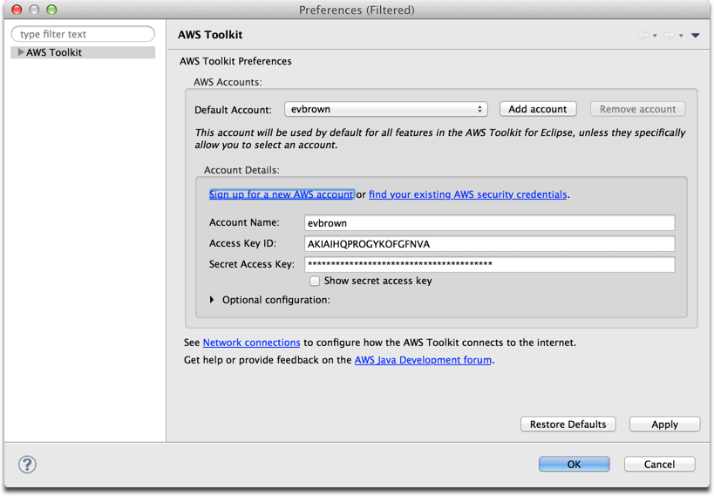
API Credentials: Local Dev
your-app.elasticbeanstalk.com
Local Dev
Users Table (DynamoDB)
Transcoding Notifications
(SQS)
Alert
ELB
Log
Elastic Beanstalk
Elastic Beanstalk API
MySQL Primary
(RDS)
Transcoding Notifications
(SNS)
Mon
App
AZ
App Storage
(S3)
IAM Instance Profile

Slide 46
API Credentials: Local Dev
App in local dev saves a video to S3
your-app.elasticbeanstalk.com
Local Dev
Users Table (DynamoDB)
Transcoding Notifications
(SQS)
Alert
ELB
Log
Elastic Beanstalk
MySQL Primary
(RDS)
Transcoding Notifications
(SNS)
Mon
App
AZ
App Storage
(S3)
IAM Instance Profile

Slide 47
API Credentials: Local Dev
your-app.elasticbeanstalk.com
Local Dev
Users Table (DynamoDB)
Transcoding Notifications
(SQS)
Alert
ELB
App in local dev creates or authenticates a user
Log
Elastic Beanstalk
MySQL Primary
(RDS)
Transcoding Notifications
(SNS)
Mon
App
AZ
App Storage
(S3)
IAM Instance Profile

Slide 48
API Credentials: Local Dev
Our app needs an AK/SK
Can’t use the creds we gave the Eclipse Toolkit
your-app.elasticbeanstalk.com
Local Dev
Users Table (DynamoDB)
Transcoding Notifications
(SQS)
Alert
ELB
Log
Elastic Beanstalk
MySQL Primary
(RDS)
Transcoding Notifications
(SNS)
Mon
App
AZ
App Storage
(S3)
IAM Instance Profile

Slide 49
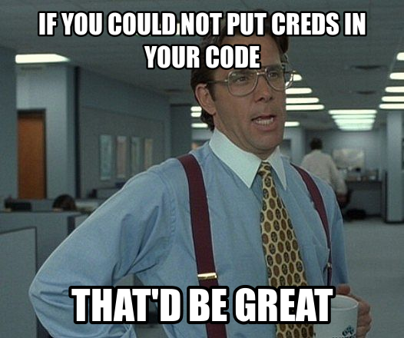
API Credentials: Local Dev
your-app.elasticbeanstalk.com
Local Dev
Users Table (DynamoDB)
Transcoding Notifications
(SQS)
Alert
ELB
Log
Elastic Beanstalk
MySQL Primary
(RDS)
Transcoding Notifications
(SNS)
Mon
App
AZ
App Storage
(S3)
IAM Instance Profile

Slide 50
API Credentials: Local Dev
Provide AK/SK as JVM args
No files; no risk of committing to source control
your-app.elasticbeanstalk.com
Local Dev
Users Table (DynamoDB)
Transcoding Notifications
(SQS)
Alert
ELB
Log
Elastic Beanstalk
MySQL Primary
(RDS)
Transcoding Notifications
(SNS)
Mon
App
AZ
App Storage
(S3)
IAM Instance Profile

Slide 51
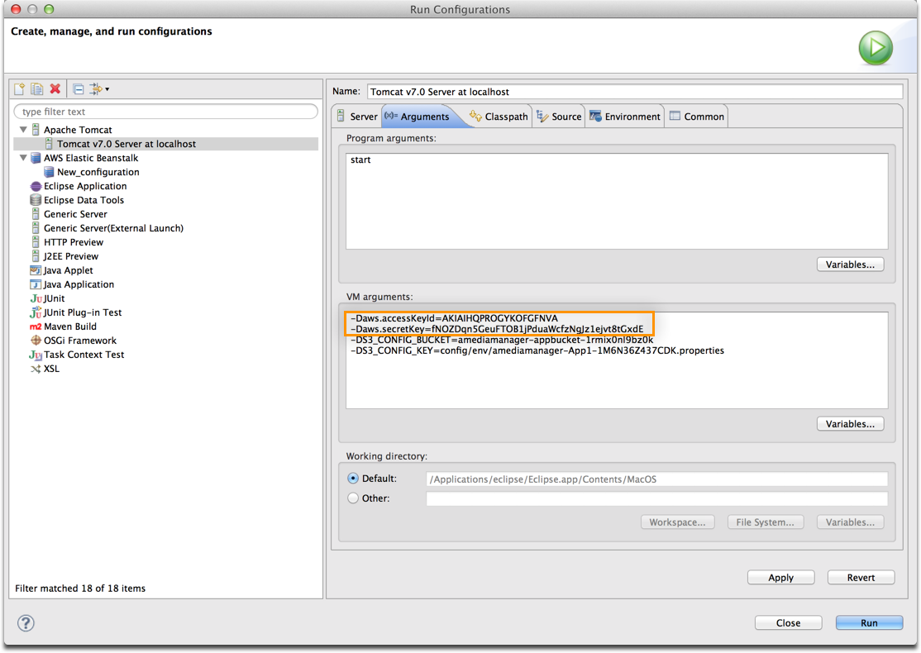
API Credentials: Local Dev
your-app.elasticbeanstalk.com
Local Dev
Users Table (DynamoDB)
Transcoding Notifications
(SQS)
Alert
ELB
Log
Elastic Beanstalk
MySQL Primary
(RDS)
Transcoding Notifications
(SNS)
Mon
App
AZ
App Storage
(S3)
IAM Instance Profile

Slide 52
API Credentials: Local Dev
We’ll configure the AWS SDK in our code to look for creds here
your-app.elasticbeanstalk.com
Local Dev
Users Table (DynamoDB)
Transcoding Notifications
(SQS)
Alert
ELB
Log
Elastic Beanstalk
MySQL Primary
(RDS)
Transcoding Notifications
(SNS)
Mon
App
AZ
App Storage
(S3)
IAM Instance Profile

Slide 53
API Credentials: Prod/EB
What about our app that’s deployed on EB?
your-app.elasticbeanstalk.com
Local Dev
Users Table (DynamoDB)
Transcoding Notifications
(SQS)
Alert
ELB
Log
Elastic Beanstalk
MySQL Primary
(RDS)
Transcoding Notifications
(SNS)
Mon
App
AZ
App Storage
(S3)
IAM Instance Profile

Slide 54
API Credentials: Prod/EB
We could provide AK/SK via JVM args, but there’s a better way
your-app.elasticbeanstalk.com
Local Dev
Users Table (DynamoDB)
Transcoding Notifications
(SQS)
Alert
ELB
Log
Elastic Beanstalk
MySQL Primary
(RDS)
Transcoding Notifications
(SNS)
Mon
App
AZ
App Storage
(S3)
IAM Instance Profile

Slide 55
API Credentials: Prod/EB
your-app.elasticbeanstalk.com
Local Dev
Users Table (DynamoDB)
Transcoding Notifications
(SQS)
Alert
ELB
Log
Elastic Beanstalk
MySQL Primary
(RDS)
Transcoding Notifications
(SNS)
Mon
App
AZ
App Storage
(S3)
IAM Instance Profile

Slide 56
API Credentials: Prod/EB
IAM profile/role “wraps” the EC2 Instance in EB and rotates new, temporary creds in every ~5 hours
your-app.elasticbeanstalk.com
Local Dev
Users Table (DynamoDB)
Transcoding Notifications
(SQS)
Alert
ELB
Log
Elastic Beanstalk
MySQL Primary
(RDS)
Transcoding Notifications
(SNS)
Mon
App
AZ
App Storage
(S3)
IAM Instance Profile

Slide 57
API Credentials: Prod/EB
We’ll configure the AWS SDK in our code to look for creds here, as well
your-app.elasticbeanstalk.com
Local Dev
Users Table (DynamoDB)
Transcoding Notifications
(SQS)
Alert
ELB
Log
Elastic Beanstalk
MySQL Primary
(RDS)
Transcoding Notifications
(SNS)
Mon
App
AZ
App Storage
(S3)
IAM Instance Profile

Slide 58
API Credentials
Any questions?

Slide 59
http://bit.ly/aws-reinvent-java
Complete the following sections:
Configure Credentials in Eclipse
Download Source and Create Project
Import EB Environment Into Eclipse
Open the Elastic Beanstalk Console
Totally optional bonus #1: where in the source code did I configure the AK/SK (i.e. the AWS Credentials Provider)?
Totally optional bonus #2: look for classes that implement ProvisionableResource in com.amediamanager.config

Slide 60
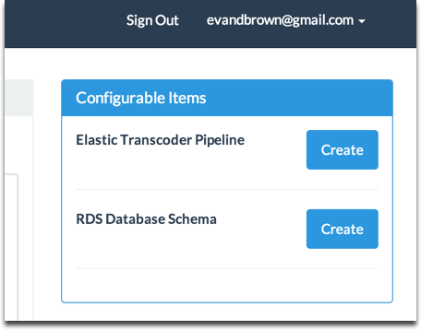
Review
What were those “Configurable” items you clicked to create?

Slide 61
Review
CloudFormation created our database server, but it doesn’t know about our schema
CloudFormation also doesn’t currently support provisioning Elastic Transcoder Pipelines

Slide 62
Review
We create them in code
Any potential issues here (considering they were created by a single EC2 instance)?

Slide 63
App Configuration

Slide 64
App Configuration
your-app.elasticbeanstalk.com
Local Dev
Users Table (DynamoDB)
Transcoding Notifications
(SQS)
Alert
ELB
Log
Elastic Beanstalk
MySQL Primary
(RDS)
Transcoding Notifications
(SNS)
Mon
App
AZ
App Storage
(S3)
IAM Instance Profile

Slide 65
App Configuration
CloudFormation created all of these resources/dependencies for us
your-app.elasticbeanstalk.com
Local Dev
Users Table (DynamoDB)
Transcoding Notifications
(SQS)
Alert
ELB
Log
Elastic Beanstalk
MySQL Primary
(RDS)
Transcoding Notifications
(SNS)
Mon
App
AZ
App Storage
(S3)
IAM Instance Profile

Slide 66
App Configuration
(Thank you, CloudFormation!)
your-app.elasticbeanstalk.com
Local Dev
Users Table (DynamoDB)
Transcoding Notifications
(SQS)
Alert
ELB
Log
Elastic Beanstalk
MySQL Primary
(RDS)
Transcoding Notifications
(SNS)
Mon
App
AZ
App Storage
(S3)
IAM Instance Profile

Slide 67
App Configuration
We have to tell our app about them
your-app.elasticbeanstalk.com
Local Dev
Users Table (DynamoDB)
Transcoding Notifications
(SQS)
Alert
ELB
Log
Elastic Beanstalk
MySQL Primary
(RDS)
Transcoding Notifications
(SNS)
Mon
App
AZ
App Storage
(S3)
IAM Instance Profile

Slide 68
App Configuration
Many ways to do this
We chose to put config in S3, load as Properties in code
your-app.elasticbeanstalk.com
Local Dev
Users Table (DynamoDB)
Transcoding Notifications
(SQS)
Alert
ELB
Log
Elastic Beanstalk
MySQL Primary
(RDS)
Transcoding Notifications
(SNS)
Mon
App
AZ
App Storage
(S3)
IAM Instance Profile

Slide 69
App Configuration
Question: how does our app know where to load config from (i.e., bucket and file key)?
Answer: Let’s look together at com.amediamanager.config.ConfigurationSettings
your-app.elasticbeanstalk.com
Local Dev
Users Table (DynamoDB)
Transcoding Notifications
(SQS)
Alert
ELB
Log
Elastic Beanstalk
MySQL Primary
(RDS)
Transcoding Notifications
(SNS)
Mon
App
AZ
App Storage
(S3)
IAM Instance Profile

Slide 70
App Configuration
(hey Evan, did you remember to show them your s3config.properties, and the Configuration section of your EB console? You should do that…)
your-app.elasticbeanstalk.com
Local Dev
Users Table (DynamoDB)
Transcoding Notifications
(SQS)
Alert
ELB
Log
Elastic Beanstalk
MySQL Primary
(RDS)
Transcoding Notifications
(SNS)
Mon
App
AZ
App Storage
(S3)
IAM Instance Profile

Slide 71
App Configuration
In the first coding challenge (soon), you’ll implement the base class (com.amediamanager.configuration.challenge.S3ConfigurationProvider)
your-app.elasticbeanstalk.com
Local Dev
Users Table (DynamoDB)
Transcoding Notifications
(SQS)
Alert
ELB
Log
Elastic Beanstalk
MySQL Primary
(RDS)
Transcoding Notifications
(SNS)
Mon
App
AZ
App Storage
(S3)
IAM Instance Profile

Slide 72
App Configuration
Another Question: how the heck did the config file get to S3 in the first place??
Answer: Definitely not magic. Let’s take a look…
your-app.elasticbeanstalk.com
Local Dev
Users Table (DynamoDB)
Transcoding Notifications
(SQS)
Alert
ELB
Log
Elastic Beanstalk
MySQL Primary
(RDS)
Transcoding Notifications
(SNS)
Mon
App
AZ
App Storage
(S3)
IAM Instance Profile

Slide 73
App Configuration
your-app.elasticbeanstalk.com
Local Dev
Users Table (DynamoDB)
Transcoding Notifications
(SQS)
Alert
ELB
Log
Elastic Beanstalk
MySQL Primary
(RDS)
Transcoding Notifications
(SNS)
Mon
App
AZ
App Storage
(S3)
IAM Instance Profile

Slide 74
App Configuration
your-app.elasticbeanstalk.com
Local Dev
Users Table (DynamoDB)
Transcoding Notifications
(SQS)
Alert
ELB
Log
Elastic Beanstalk
MySQL Primary
(RDS)
Transcoding Notifications
(SNS)
Mon
App
AZ
App Storage
(S3)
IAM Instance Profile
Provided to EB and Instance as environment vars

Slide 75
App Configuration
We put a Python script in WEB-INF/.ebextensions/deploy_config.py
your-app.elasticbeanstalk.com
Local Dev
Users Table (DynamoDB)
Transcoding Notifications
(SQS)
Alert
ELB
Log
Elastic Beanstalk
MySQL Primary
(RDS)
Transcoding Notifications
(SNS)
Mon
App
AZ
App Storage
(S3)
IAM Instance Profile

Slide 76
App Configuration
We put a Python script in WEB-INF/.ebextensions/deploy_config.py
Earlier you configured Eclipse to bundle the .ebextensions dir with your WAR…
your-app.elasticbeanstalk.com
Local Dev
Users Table (DynamoDB)
Transcoding Notifications
(SQS)
Alert
ELB
Log
Elastic Beanstalk
MySQL Primary
(RDS)
Transcoding Notifications
(SNS)
Mon
App
AZ
App Storage
(S3)
IAM Instance Profile

Slide 77
App Configuration
We put a Python script in WEB-INF/.ebextensions/deploy_config.py
Earlier you configured Eclipse to bundle the .ebextensions dir with your WAR…
your-app.elasticbeanstalk.com
Local Dev
Users Table (DynamoDB)
Transcoding Notifications
(SQS)
Alert
ELB
Log
Elastic Beanstalk
MySQL Primary
(RDS)
Transcoding Notifications
(SNS)
Mon
App
(hey Evan, why don’t you Alt+Tab and show them?)
AZ
App Storage
(S3)
IAM Instance Profile

Slide 78
Break Time (15 minutes)!
After break, a few labs:
Import App Config for Local Dev
Modify and Deploy Application
Roll Back to Initial Version
Project Anatomy

Slide 79
LAB TIME: 30 minutes
Complete the following sections:
Import App Config for Local Dev
Modify and Deploy Application
Roll Back to Initial Version
Project Anatomy

Slide 80
Review
Project Anatomy
The app just works
You override implemented methods from base class and implement

Slide 81
AWS SDK for Java

Slide 82
AWS SDK for Java
Work with services by creating service objects:
By default, a client connects to service endpoint in us-east-1
AmazonS3 s3 = new com.amazonaws.services.s3.AmazonS3Client();
AmazonRDS rds = new com.amazonaws.services.rds.AmazonRDSClient();
// etc…

Slide 83
Java SDK & Regional Agnosticism
What is a region?

Slide 84
Java SDK & Regional Agnosticism
What is a region?
Why would we want our app to work in a region besides us-east-1?

Slide 85
Java SDK & Regional Agnosticism
Best Practice:
Create service clients from a Region object:
Region region = Region.getRegion(Regions.fromName(“us-west-2”));
AmazonRDS rdsClient = region.
createClient(
AmazonRDSClient.class, creds, null
);

Slide 86
S3 Overview

Slide 87
S3 Overview
Object storage for the Internet
Objects stored in buckets
100 buckets/account
Unlimited objects/bucket
5TB/object

Slide 88
S3 API
HTTP Query API
HEAD
GET
POST
PUT
DELETE

Slide 89
S3 and the Java SDK
// Get a client (S3 clients don’t care about regions…)
AmazonS3 s3Client = new AmazonS3Client();
// Get an object
S3Object object = s3Client.getObject(this.bucket, this.key);

Slide 90
CHALLENGE OVERVIEW
(hey Evan, why don’t you Alt+Tab and walk through challenges in the course manual)

Slide 91
CHALLENGE TIME: 20 minutes
Get App Config From S3
Super Powers | Resources (Google ‘em) | Considerations
super.getBucket() super.getKey() super.setProperties() | The AWS SDK for Java The AmazonS3 interface The AmazonS3Client class | Have fun, and refer to the ‘Challenge: Get App Config From S3’ section of the lab manual. I spent a lot of time writing it and it would mean a lot to me.

Slide 92
Review
Look at com.amediamanager.config.S3ConfigurationProvider

Slide 93
DynamoDB Overview

Slide 94
DynamoDB Overview
Fully-managed NoSQL database service
Store any amount of data – no limits
Easily provision and change the request capacity needed for each table
Fast, predictable performance using SSDs

Slide 95
DynamoDB Data Model
Table = Collection of Items
Item = Arbitrary collection of Name-Value attribute pairs
Primary Key only mandatory attribute
64KB Item Size limit

Slide 96
DynamoDB Primary Keys
Single Hash Key
Distributed Hash Table abstraction
Hashing maximizes workload distribution
No Query Support: (Batch)Put, (Batch)Get, Scan only
Composite Hash, Range Key
Items grouped by Hash Key & sorted by Range Key
Hash Groups have no size limits

Slide 97
DynamoDB Single Hash Key
API: GetItem, PutItem, UpdateItem, BatchWriteItem, BatchGetItem, Scan
EMail (hash key) | Password | Nickname | ProfilePic
foo@bar.com | !@##21322-- | Evan | http://bucket.s3.amazonaws.com…
baz@foo.com | *(U$@!23323-- | Elli

Slide 98
CHALLENGE TIME: 30 minutes
DynamoDB and Users
Super Powers | Resources (Google ‘em) | Considerations
super.config super.HASH_KEY_NAME super.dynamoClient super.getUserFromMap super.getMapFromUser super.LOG | The AmazonDynamoDB interface in the docs | Item attribute names you should use are in super (e.g., super.EMAIL_ATTR has the name of the item attribute you should store the user’s e-mail address with)

Slide 99
Review
Look at com.amediamanager.dao.DynamoDbUserDaoImpl

Slide 100
Complexity Checkpoint
Is this too easy for anyone?
Improve the app this afternoon:
Replace DynamoDB auth with Login With Amazon (login.amazon.com)
Store videos and associated metadata in DynamoDB instead of RDS
Build a DynamoDBConfigurationProvider that extends com.amediamanger.config.ConfigurationProvider

Slide 101
Lunch Time!
Starting back promptly at 1:30p

Slide 102
Complexity Checkpoint
Is this too easy for anyone?
Improve the app this afternoon:
Replace DynamoDB auth with Login With Amazon (login.amazon.com)
Store videos and associated metadata in DynamoDB instead of RDS
Build a DynamoDBConfigurationProvider that extends com.amediamanger.config.ConfigurationProvider

Slide 103
RDS Overview

Slide 104
RDS Overview
Fully-managed relational database
MySQL, Oracle, and RDS
API
Resize (CPU/Memory, Storage, IOPS)
Snapshot
MultiAZ
Read Replicas
Etc…

Slide 105
RDS Overview – Read Replicas
Read-only copies of master
Create on-demand to increase read performance
Destroy when no longer needed

Slide 106
RDS Overview – Read Replicas
your-app.elasticbeanstalk.com
Alert
ELB
Log
Elastic Beanstalk
Mon
App
AZ
MySQL Primary

Slide 107

RDS Overview – Read Replicas
Provision Read Replica (API, Console, etc) when app needs to scale reads
your-app.elasticbeanstalk.com
Alert
ELB
Log
Elastic Beanstalk
Mon
App
AZ
MySQL Primary
Read Replica #1

Slide 108
RDS Overview – Read Replicas
your-app.elasticbeanstalk.com
Alert
ELB
Log
Read Replica #2
Elastic Beanstalk
Mon
App
AZ
MySQL Primary
Read Replica #1

Slide 109
RDS Overview – Read Replicas
Your app is responsible for discovering and incorporating the Read Replicas
your-app.elasticbeanstalk.com
Alert
ELB
Log
Read Replica #2
Elastic Beanstalk
Mon
App
AZ
MySQL Primary
Read Replica #1

Slide 110
RDS Overview – Read Replicas
your-app.elasticbeanstalk.com
Alert
RDS API
ELB
Log
Read Replica #2
App queries RDS API on launch for DB endpoints and uses the appropriate driver if RRs are present (i.e., com.mysql.jdbc.ReplicationDriver)
Elastic Beanstalk
Mon
App
AZ
MySQL Primary
Read Replica #1

Slide 111
RDS Overview – Read Replicas
your-app.elasticbeanstalk.com
Alert
ELB
Log
Elastic Beanstalk
Mon
App
AZ
MySQL Primary
Read Replica #1

Slide 112
RDS Overview – Read Replicas
your-app.elasticbeanstalk.com
Alert
ELB
Log
Elastic Beanstalk
Mon
App
AZ
MySQL Primary

Slide 113
CHALLENGE TIME: 30 minutes
Complete the following challenge:
RDS, Read Replicas, and Connection Discovery

Slide 114
CHALLENGE TIME: 30 minutes
RDS, Read Replicas, and Connection Discovery
Super Powers | Resources (Google ‘em) | Considerations
super.rds super.config super.LOG | AmazonRDS interface in the docs DBInstance class docs | Look to the master DBInstance for Read Replicas, and be sure any Read Replicas are in the ‘available’ state before returning them.

Slide 115
Review
Look at com.amediamanager.dao.RdsDbEndpointRetriever

Slide 116
S3 Objects
Objects in S3 have metadata
Metadata is exposed via headers in HTTP response
Objects are private by default
(hey Evan, why don’t you Alt+Tab and show ‘em a curl -I)

Slide 117
CHALLENGE TIME: 45 minutes
Includes 15 minute break, 2:30-2:45

Slide 118
CHALLENGE TIME: 30 minutes
S3 for Profile Pictures
Super Powers | Resources (Google ‘em) | Considerations
super.s3Client super.config super.LOG | AmazonS3 interface in the docs | Define a good naming scheme for the photos config.getProperty(ConfigProps.S3_PROFILE_PIC_PREFIX) has pre-defined key prefix Object should have a public read ACL Return the URL of the photo.

Slide 119
Review
Look at com.amediamanager.dao.DynamoDbUserDaoImpl

Slide 120

Elastic Transcoder
Transcode videos
Store transcoded files in S3
Create thumbnails
Schedule transcode in a pipeline
Results posted to SNS

Slide 121
Elastic Transcoder
your-app.elasticbeanstalk.com
Alert
ELB
Log
Elastic Beanstalk
Mon
App
AZ
Elastic Transcoder Pipeline

Slide 122
Elastic Transcoder
your-app.elasticbeanstalk.com
CreateJob
Alert
ELB
Log
Elastic Beanstalk
Mon
App
AZ
Elastic Transcoder Pipeline

Slide 123
Elastic Transcoder
Elastic Transcoder begins converting your video…
your-app.elasticbeanstalk.com
Alert
ELB
Log
Elastic Beanstalk
Mon
App
AZ
Elastic Transcoder Pipeline

Slide 124
Elastic Transcoder
your-app.elasticbeanstalk.com
Transcoded video stored in S3
Alert
ELB
Log
Elastic Beanstalk
Mon
App
AZ
Elastic Transcoder Pipeline
App Bucket

Slide 125
Elastic Transcoder
your-app.elasticbeanstalk.com
DescribeJobStatus
Alert
ELB
Log
Elastic Beanstalk
Mon
App
AZ
Elastic Transcoder Pipeline

Slide 126
Elastic Transcoder
your-app.elasticbeanstalk.com
Alert
ELB
Log
SQS Queue
SNS Topic
Elastic Beanstalk
Publish ‘Completed’ status notification to SNS
Mon
App
AZ
Elastic Transcoder Pipeline

Slide 127
Elastic Transcoder
your-app.elasticbeanstalk.com
Alert
ELB
Log
SQS Queue
Elastic Beanstalk
App polls SQS every 20 seconds checking for ‘Completed’ notifications
Mon
App
AZ
Elastic Transcoder Pipeline

Slide 128
Elastic Transcoder
your-app.elasticbeanstalk.com
Update video record in RDS (i.e., thumbnail URL and streaming URL)
Alert
ELB
Log
SQS Queue
Elastic Beanstalk
Mon
App
AZ
Elastic Transcoder Pipeline
MySQL Primary

Slide 129
CHALLENGE TIME: 30 minutes
Complete the following challenge:
Elastic Transcoder Service

Slide 130
CHALLENGE TIME: 30 minutes
Elastic Transcoder Service
Super Powers | Resources (Google ‘em) | Considerations
super.sqsClient super.config super.LOG | AmazonSQS interface in the docs | Queue URL is at config.getProperty(ConfigProps.TRANSCODE_QUEUE) Your checkStatus() implementation must call super.handleMessage() for each message it receives.

Slide 131
Review
Look at com.amediamanager.scheduled.ElasticTranscoderTasks
Upload a video and inspect how the form POSTs

Slide 132
CloudWatch

Slide 133
CloudWatch
Monitoring and metrics
Alarm when thresholds are breached
Visibility into resource utilization, operational performance, and demand patterns
E.g., CPU utilization, disk I/O, network traffic, etc…

Slide 134
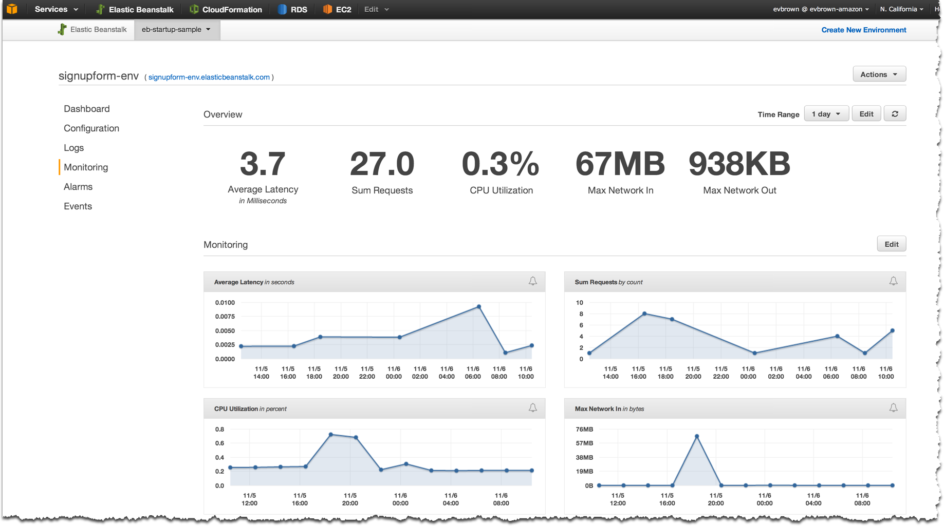
CloudWatch – Web App Metrics from EB

Slide 135
CloudWatch
API supports putting custom metrics:
PutMetricDataAsync
Custom metrics: anything you like
What are some custom metrics we might like in aMediaManager?

Slide 136
CHALLENGE TIME: 45 minutes
Emit Custom CloudWatch Metrics
Super Powers | Resources (Google ‘em) | Considerations
super.newDatum() super.metricBatcher() | MetricDatum class docs | Too many to fit here. Check out that sweet course manual.

Slide 137
Review
Look at com.amediamanager.metrics.MetricAspect

Slide 138
Questions?

Slide 139
Thank You!
Be sure to check out sessions for services or topics that piqued your interest!
Please leave feedback on this workshop

